Slide 1

DAYANANDA SAGAR COLLEGE OF ENGINEERING,
SHAVIGE MALLESHWARA HILLS, K.S. LAYOUT, BANGALORE -560078.
DEPARTMENT OF COMPUTER SCIENCE AND ENGINEERING
SCHEDULING ALGORITHMS OF OS WITH GUI
Team Members :
Rhuthu Hegde(1DS18CS731)
Rithvik K Bhat(1DS18CS732)
Roopa Shree S P(1DS18CS733)

Slide 2
ABSTRACT:
This project aims to implement the various CPU scheduling algorithms and display a GUI with all the algorithms, so that the user can select the algorithm which he/she wants to execute by giving the arrival time and the process time. The user can add or delete the number of processes. After the calculation, a Gantt chart is displayed with the processes, also a final table with processes, arrival time, total burst time, completion time, turnaround time, waiting time and response time is displayed to the user.

Slide 3
Languages/Technologies Used
TOOLS : A windows system with 8GB ram and cire i3 and the Visual Studio code.
TECHNOLOGIES: Bootstrap5,HTML,CSS,JAVASCRIPT

Slide 4
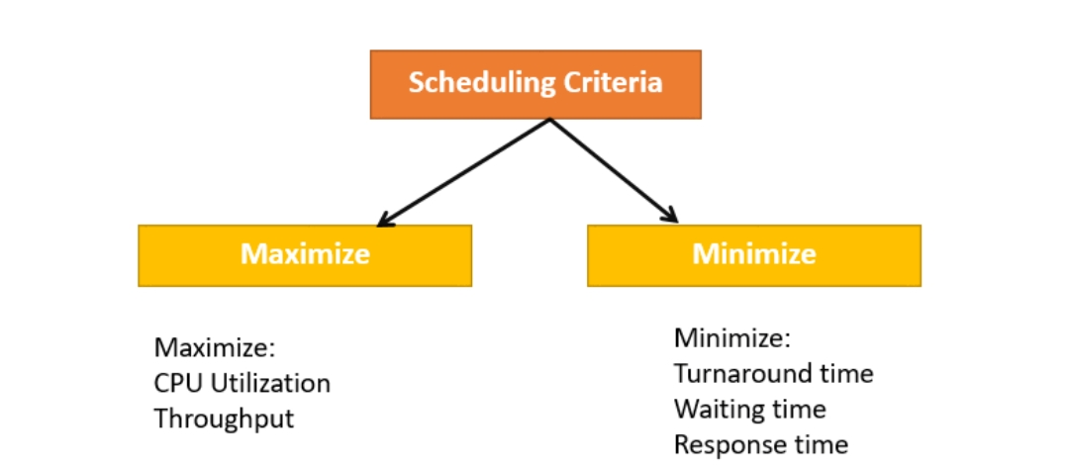
INTRODUCTION:
CPU Scheduling is a process of determining which process will own CPU for execution while another process is on hold. A Process Scheduler schedules different processes to be assigned to the CPU based on particular scheduling algorithms.
These algorithms are either non-preemptive or preemptive.
Preemptive Scheduling: The tasks are mostly assigned with their priorities.
Non-Preemptive Scheduling: The CPU has been allocated to a specific process.
The important terminologies are Burst Time/Execution Time, Arrival Time, Finish Time, Multiprogramming, Jobs, User, Process, CPU/IO burst cycle.
The Scheduling algorithm should maximise the CPU utilisation and throughput and minimise the waiting, response and turnaround time.

Slide 5
Burst time is a time required for the process to complete execution. It is also called running time.
CPU utilization is the main task in which the operating system needs to make sure that CPU remains as busy as possible
The number of processes that finish their execution per unit time is known Throughput.
Waiting time is an amount that specific process needs to wait in the ready queue. It is an amount to time in which the request was submitted until the first response is produced.
Turnaround time is an amount of time to execute a specific process. Timer interruption is a method that is closely related to preemption.
A dispatcher is a module that provides control of the CPU to the process.

Slide 6
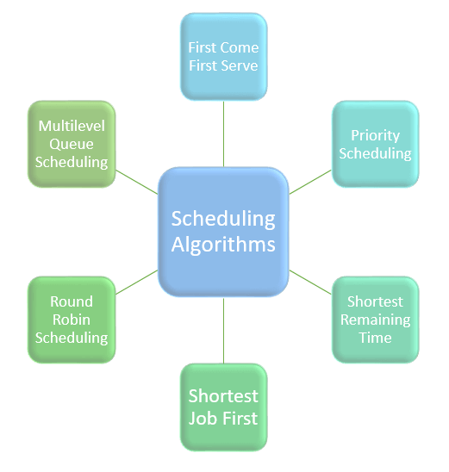
There are mainly six types of process scheduling algorithms :
First Come First Serve (FCFS)/First in First Out (FIFO)
Shortest-Job-First (SJF) Scheduling
Shortest Remaining Time
Priority Scheduling(Pre-emptive)
Priority Scheduling(Non preemptive)
Round Robin Scheduling

Slide 7
In First Come First Serve method, the process which requests the CPU gets the CPU allocation first.
In the Shortest Remaining time, the process will be allocated to the task, which is closest to its completion.
In, Priority Scheduling the scheduler selects the tasks to work as per the priority.
In, Round robin scheduling works on principle, where ‘each person gets an equal share of something in turn’.
Shortest job first the shortest execution time should be selected for execution next
In Multilevel scheduling, method separates the ready queue into various separate queues. In this method, processes are assigned to a queue based on a specific property. The CPU uses scheduling to improve its efficiency.

Slide 8
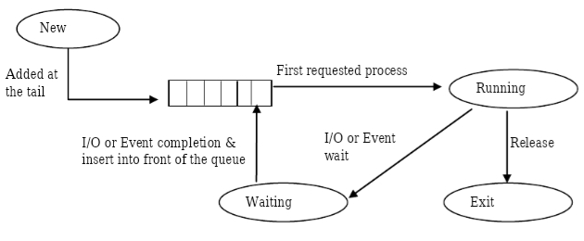
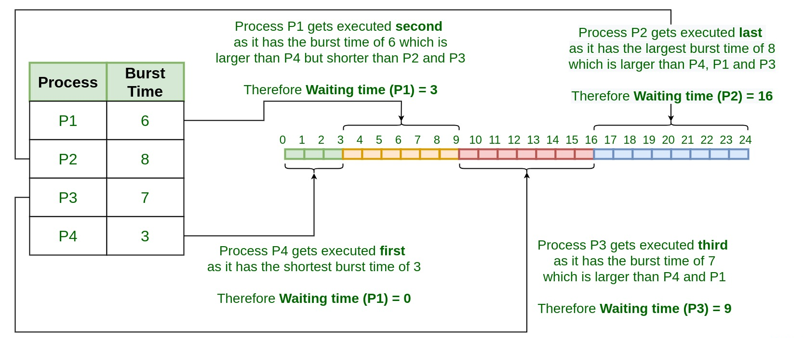
DESIGN
First come first serve
Shortest Job First

Slide 9
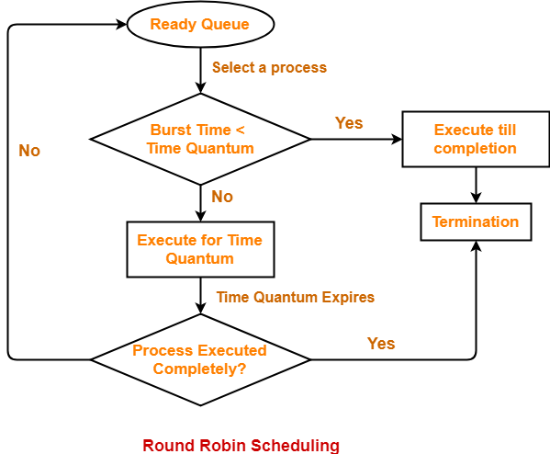
Round Robin

Slide 10
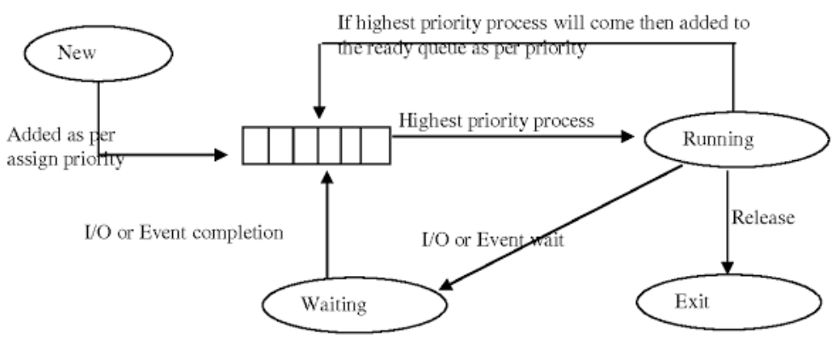
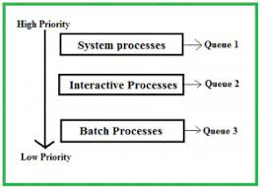
Priority Based Scheduling
Multilevel-Queue

Slide 11
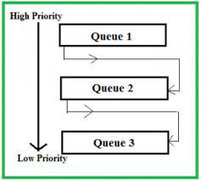
Multilevel-Queue Feedback

Slide 12
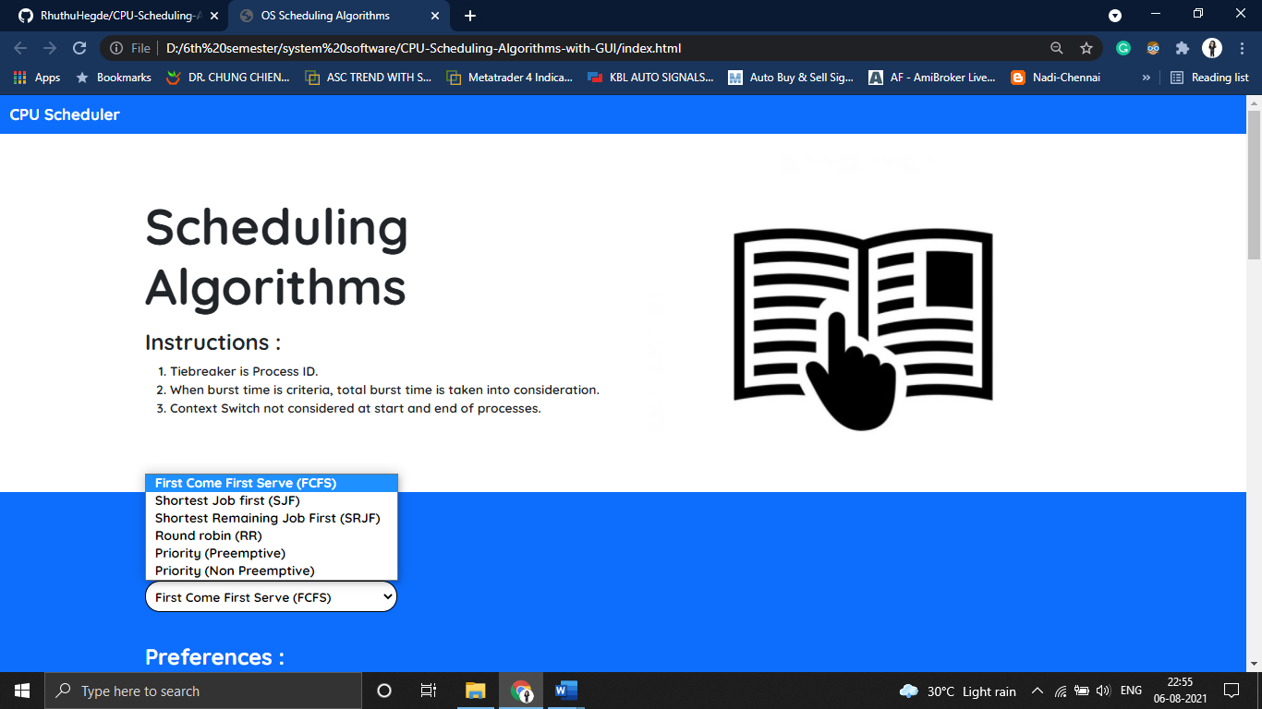
UI SCREENSHOTS
To select the CPU Scheduling algorithm

Slide 13
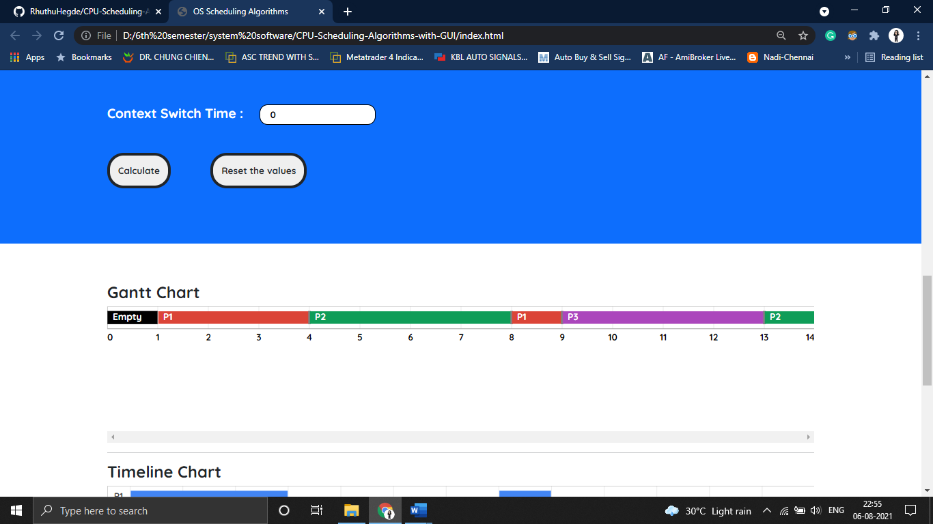
After calculating it displays a Gantt Chart with the processes and time taken.

Slide 14
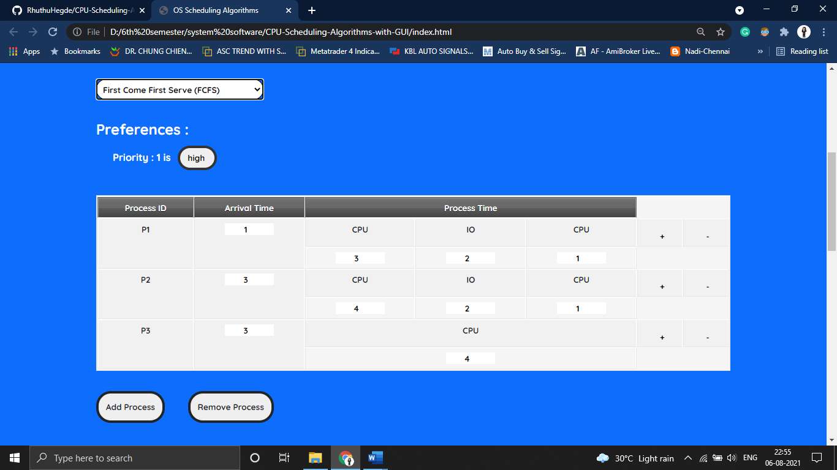
Edit the CPU time and IO time as optional for the individual processes.

Slide 15
It also displays a timeline chart which gives the duration of each process.

Slide 16
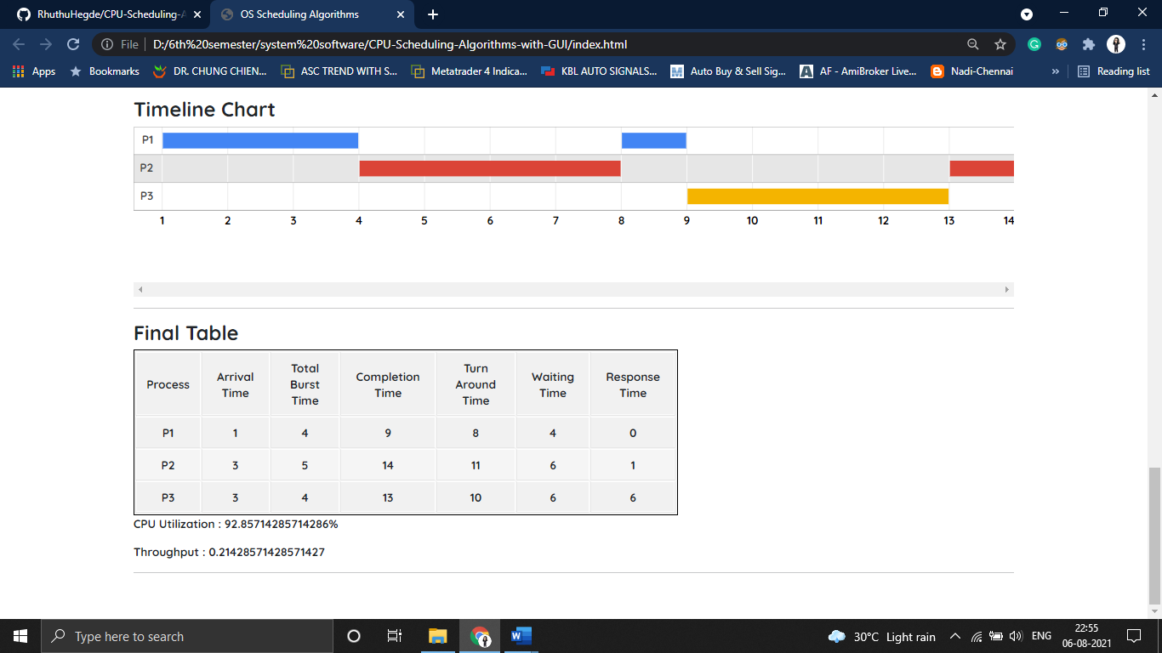
A final table with names of the processes, its arrival time, total burst time, completion time, turn around time, waiting time and response time is displayed

Slide 17
FUTURE ENHANCEMENT
As an enhancement feature, time log feature can be added which shows the processes step by step from ready queue, waiting state, running, and also process termination.

Slide 18
Conclusion
CPU scheduling is a process of determining which process will own CPU for execution while another process is on hold.
The CPU uses scheduling to improve its efficiency.
It helps you to allocate resources among competing processes.
The maximum utilization of CPU can be obtained with multi-programming.
Six types of process scheduling algorithms are: First Come First Serve (FCFS), 2) Shortest-Job-First (SJF) Scheduling 3) Shortest Remaining Time 4) Priority Scheduling 5) Round Robin Scheduling 6) Multilevel Queue Scheduling.
In this project we are going to demonstrate all these algorithm using a GUI.

Slide 19
THANK YOU

